Slide 1

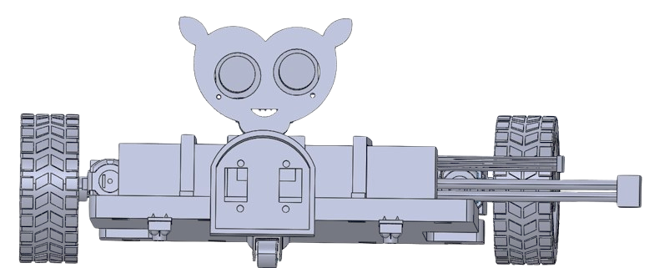
Welcome to our presentation
Arduino base Autonomous vehicles
Course Tittle: Prototyping and System Engineering
Team: A3
Members:
John Abiagam
Omar Latif
Md Akram

Slide 2
Motivation
Arduino base Autonomous vehicles
Line detection and following
Obstacles detection and avoidance
Color identification
Parking vehicle

Slide 3
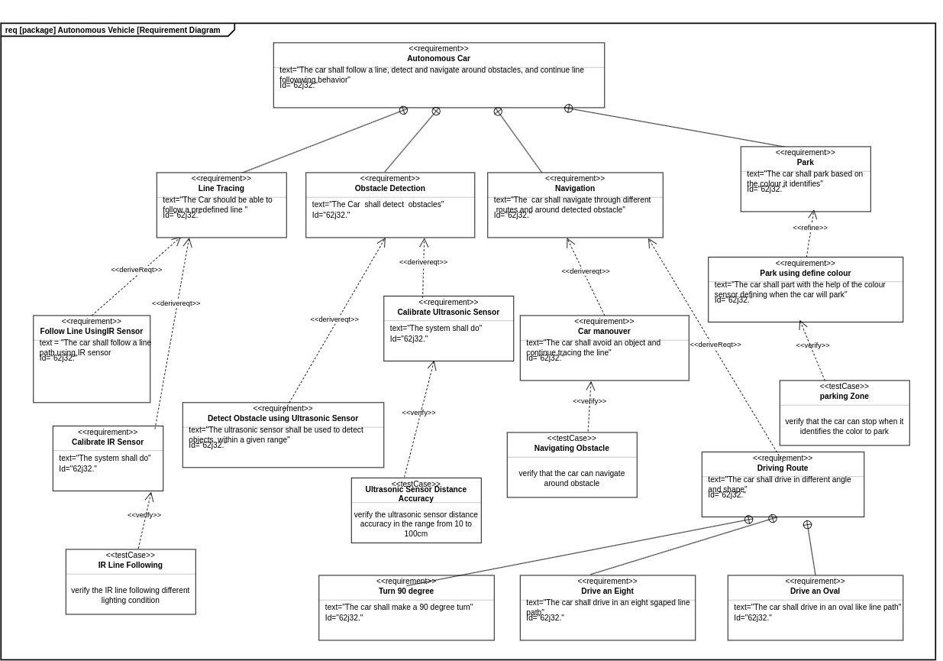

Slide 4

Hardware components
Arduino Uno / Nano
Color Sensor
L298N Motor Driver Module
2x IR Line Sensors
Ultrasonic Sensor (HC-SR04)
2 DC Motors + wheels
Power supply (battery pack)
Chassis
Jumper wires

Slide 5
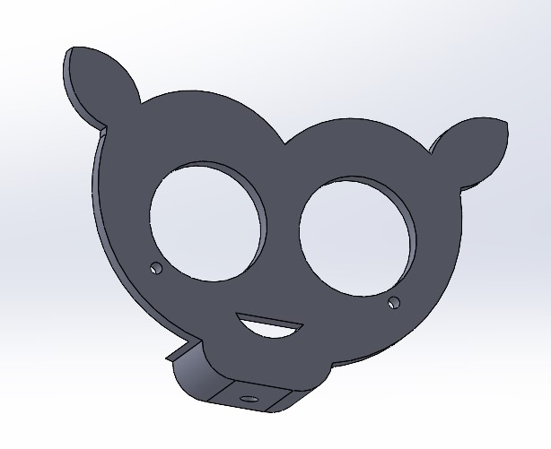
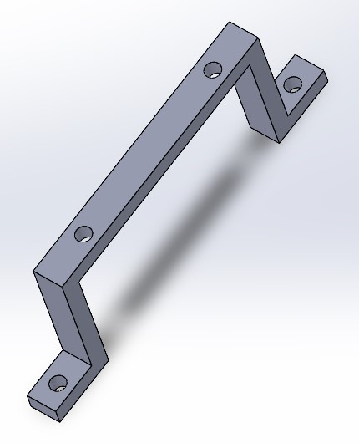
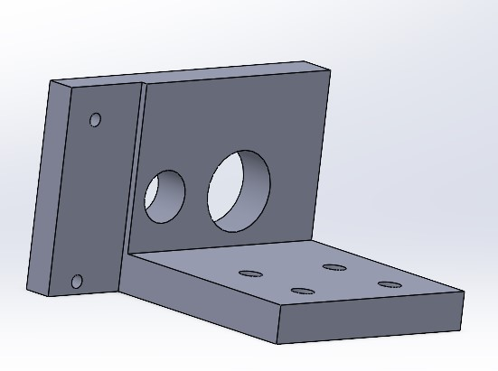
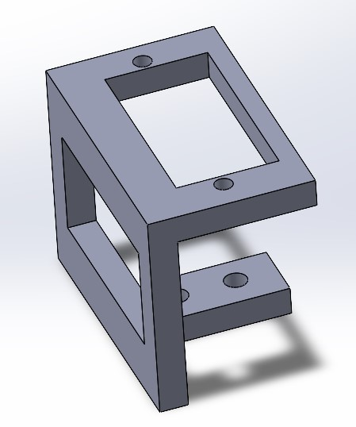
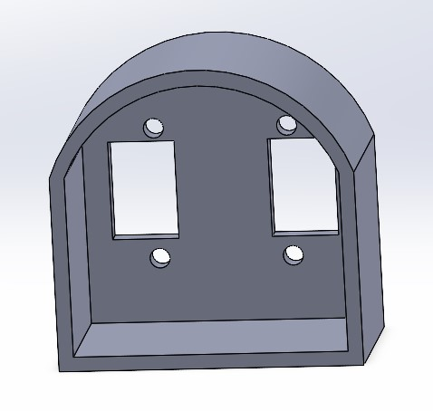
3D Design
Ultrasonic Sensor holder
Battery holder
Motor older
SOLIDWORKS Motion study and Exploded view
Color Sensor holder
Servo holder

Slide 6
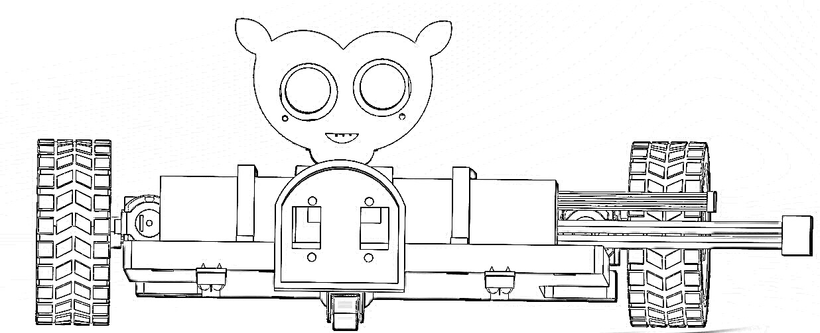
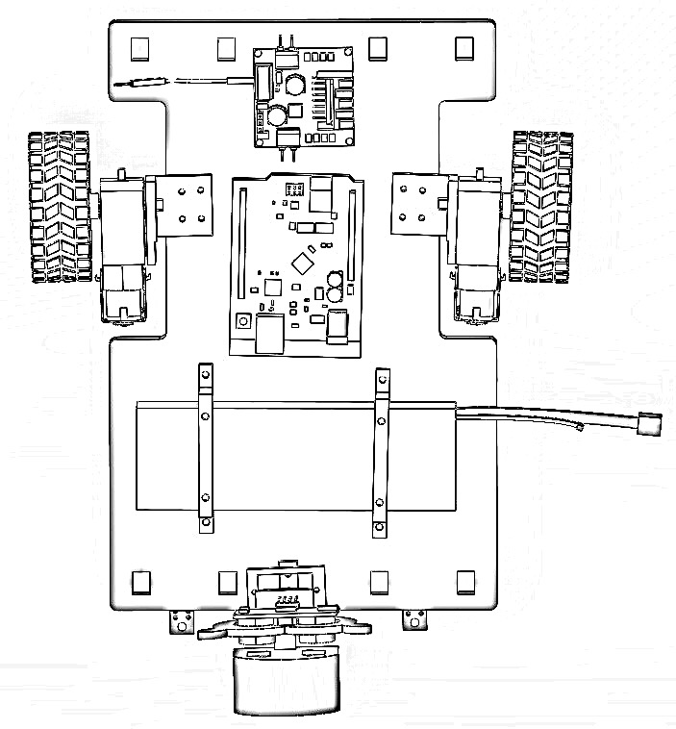
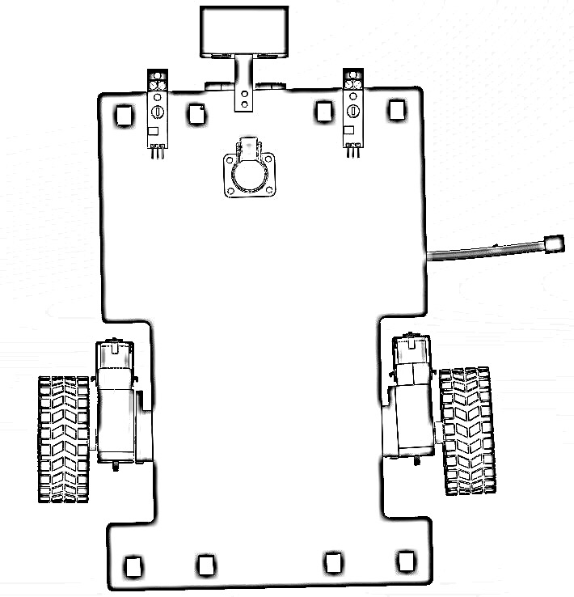
Paper Sketch
Front View
Top View
Bottom View

Slide 7

Assembly Process
01
Checklist Observation
Components Mounting
Electrical Connection
Cleaning of 3D parts
Place components in holder
Careful about enough support
Place all in main surface
Check about weight balance
Check datasheet
Understand schematics
Connect the signal pin
Connect power and Ground
Double check every connection
All 3D parts are present
All components are present
Assembly tools present
Paper Sketch present

Slide 8
Assembly Process
01
02
Checklist Observation
Components Mounting
Electrical Connection
Cleaning of 3D parts
Place components in holder
Careful about enough support
Place all in main surface
Check about weight balance
Check datasheet
Understand schematics
Connect the signal pin
Connect power and Ground
Double check every connection
All 3D parts are present
All components are present
Assembly tools present
Paper Sketch present

Slide 9
Assembly Process
01
02
03
Checklist Observation
Components Mounting
Electrical Connection
Cleaning of 3D parts
Place components in holder
Careful about enough support
Place all in main surface
Check about weight balance
Check datasheet
Understand schematics
Connect the signal pin
Connect power and Ground
Double check every connection
All 3D parts are present
All components are present
Assembly tools present
Paper Sketch present

Slide 10
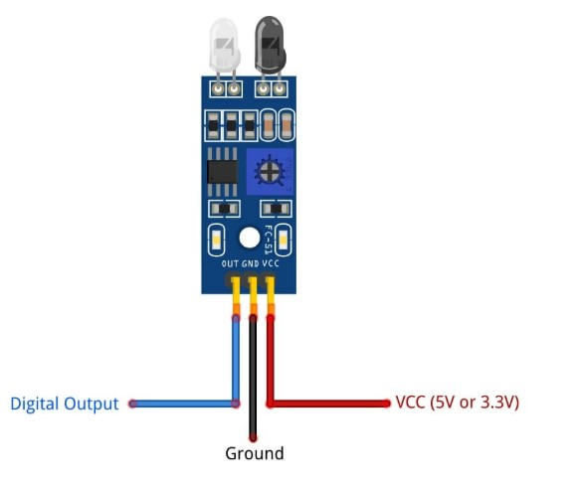
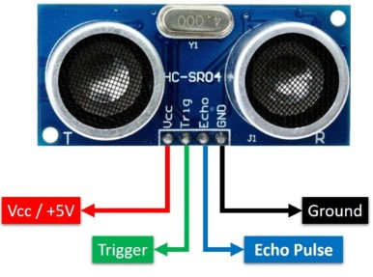
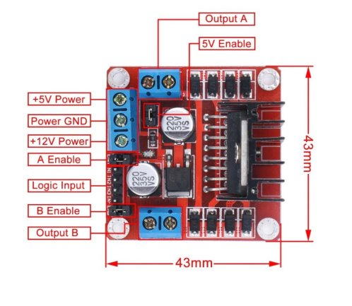
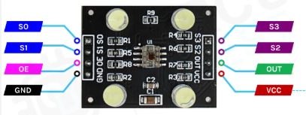
Pin Layout

Slide 11

Unit test challenges and observation with time
05
Light intensity and power supply can effect on performance
04
Angle and Position can effect on it performance.
03
Environment, light intensity and position effect on performance
02
01
IR Sensor
Ultrasonic Sensor
Color Sensor
Training Accuracy and Loss

Slide 12
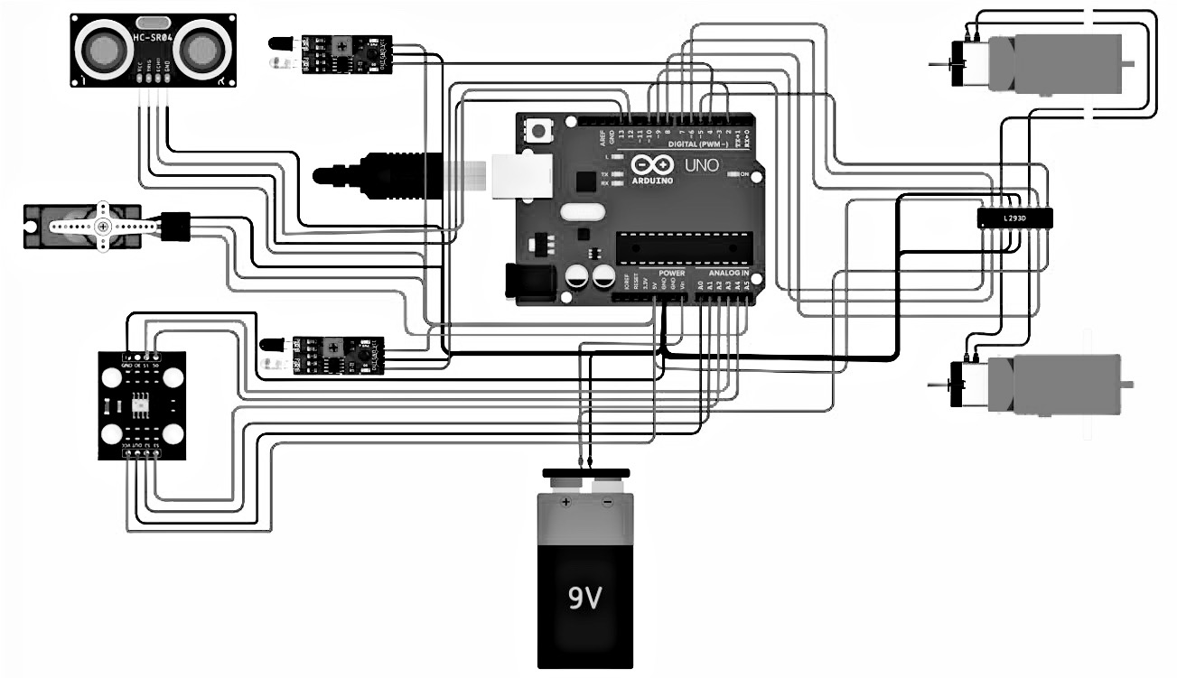
Schematics Diagram

Slide 13
Thinkercad Simulation

